Slide 1
Image blending
Annie Dai, Xinbei Fu
CS 189 Final Project
Notes:
Hi everyone, today we are going to present our final project, image blending

Slide 2
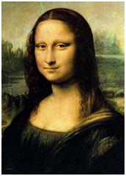
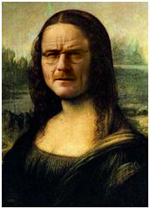


Motivation
+
=
Notes:
So, image blending is what you can think of when you want to make funny images like put someone’s face on mona lisa. There are two mostly used image blending algorithms, laplacian pyramid blending and poisson blending. We implemented both of them, and compared the results

Slide 3
Laplacian pyramid blending

Slide 4
http://sepwww.stanford.edu/data/media/public/sep/morgan/texturematch/paper_html/node3.html
Laplacian pyramid blending
Last level = gaussian last level
Laplacian level i = gaussian level i – expand(gaussian level i+1)
Notes:
Laplacian pyramid blending is based on laplacian pyramid representation which subsamples an image to reducing resolutions.
So say you have image f0, you first do a gaussian blur and then subsample to ½ resolution of f0 to get f1, and you do it repeatedly until get to the minmum resolution you can get, this is called gaussian pyramid. For laplacian pyramid, you just subtract higher gaussian pyramid level from current gaussian level. And for the last level, just assign it with the gaussian pyramid level. Basically, laplacian pyramid stores high frequency information.
If you want to recover the image from all the laplacian levels, you just add them up.

Slide 5
Laplacian pyramid blending
General approach :
Build Laplacian pyramids LA and LB from images A and B
Build a Gaussian pyramid GR from mask image.
Form a combined pyramid LS from LA and LB using nodes of GR as weights:
LS(i, j) = GR(i, j) * LA(i, j) + (1 – GR(i, j)) * LB(i, j)
Collapse the LS pyramid to get the final balanced image
Notes:
Well, the general approach for laplacian pyramid blending is first you build two laplacian pyramids from source image and target image respectively, then build a gaussian pyramid from mask image, and next you form a combined pyramid from source image and target image using gr as weights. So for every level, you do this calculation. Finally, you collapse the pyramid to get the result.

Slide 6
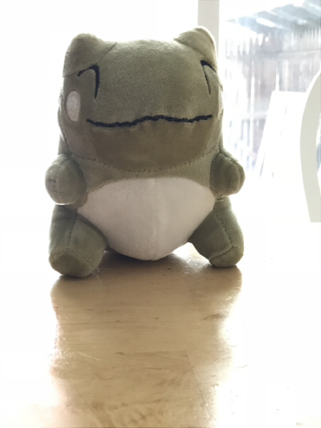
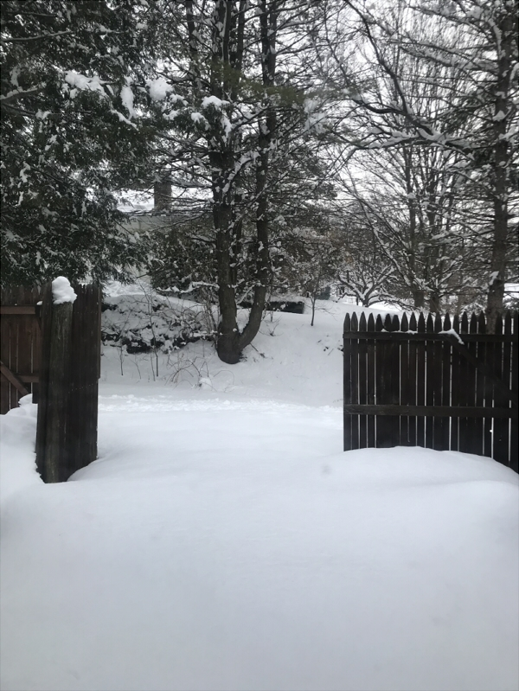
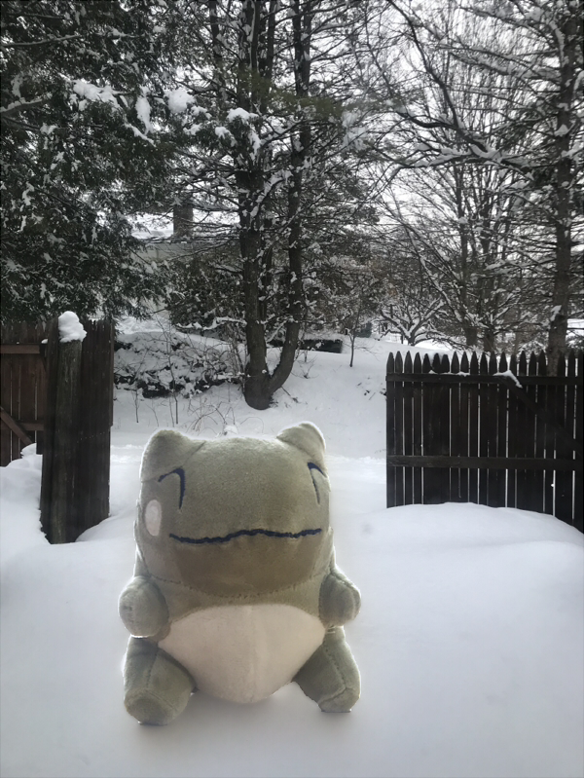
Laplacian pyramid blending
+
=
Notes:
This is one is this cute dinosaur sitting in the snow of our yard.

Slide 7
Poisson blending

Slide 8
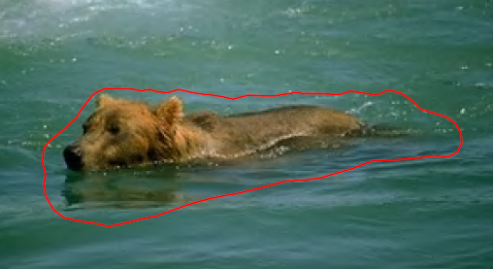
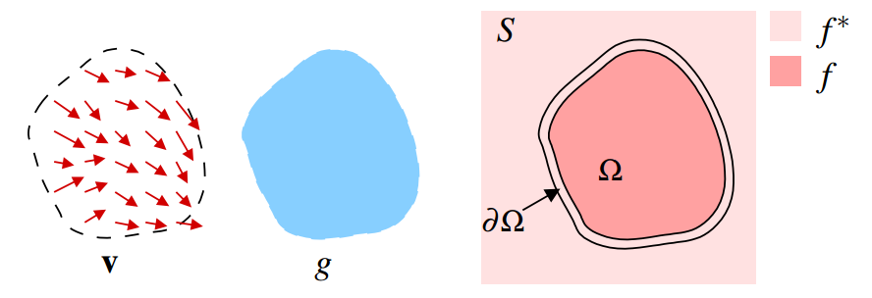
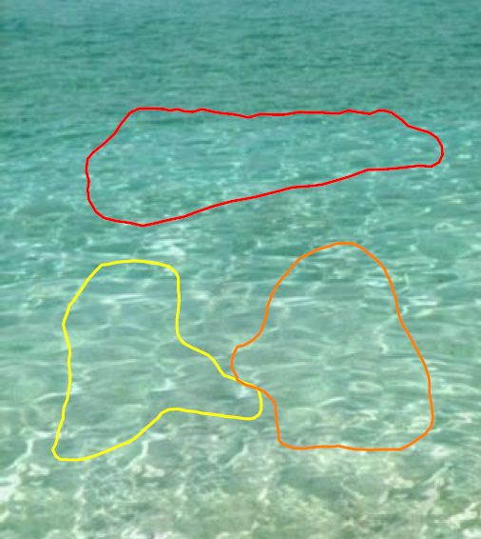
Poisson blending
v – Gradient of a region in an image
g – Selected region of source
f* – Known functions that exist in domain S
f – Unknown functions that exist in domain Ω
Ω – Region g that is now placed on domain S
∂Ω – Boundaries between the source and target regions
[Patrick et al. 03]
Notes:
Theory
Poisson blending is one of gradient domain image processing methods
In poisson blending, we are given a source image and a target image. We then mask the object in the source that we want, and also do the same to the target image to indicate where should the object be.
However, instead of copy and paste the value of source image to target image, we copy the gradient from source to target.

Slide 9
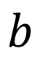


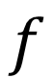

Poisson blending
[Patrick et al. 03]
, with
, for all
Solution:
$$A$$
$$∗$$
$$f$$
$$=$$
$$b$$
Gradient
operator
Blended
source
Source gradient
with
Boundary condition
Notes:
So our goal is, while matching the boundary condition from target image (fp = fp*), we want to minimized the difference between our source gradient (v_pq) and out final gradient (fp-fq) within the region of mask.
Whose solution is the solution of Poisson equation:
We want to solve for f such that its gradient will be close to b, the source gradient with a boundary conditions for the target image.

Slide 10
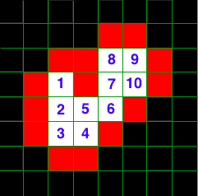
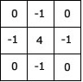
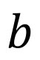

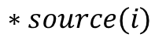
Poisson blending
 | 1 | 2 | 3 | 4 | 5 | 6 | 7 | 8 | 9 | 10
1 | 4 | -1
2 | -1 | 4 | -1 |  | -1
3 |  | -1 | 4 | -1
4 |  |  | -1 | 4 | -1
5 |  | -1 |  | -1 | 4 | -1
6 |  |  |  |  | -1 | 4 | -1
7 |  |  |  |  |  | -1 | 4 | -1 |  | -1
8 |  |  |  |  |  |  | -1 | 4 | -1
9 |  |  |  |  |  |  |  | -1 | 4 | -1
10 |  |  |  |  |  |  | -1 |  | -1 | 4
$$A$$
$$b\left[i\right]=div\left(source\left(i\right)\right)+NeighborOnBoundary\left(target(i)\right)$$
$$b$$
http://eric-yuan.me/poisson-blending/
$$∗source(i)$$
Notes:
So taking a visual example, we have a mask that look like the left image, where the number are the indices of pixels, for this example we have 10 pixels in the mask
So for pixel in the mask, A is a sparse matrix of 10 by 10, where all diagonal = 4, and all columns indices that are neighbor to the row indices are = -1
B is a vector that represent the final gradient we want to get within the region of mask, so we compute the gradient and add the boundary condition (which are the red grid on the left)
For everything outside of mask, A is just identity matrix, and b is the pixel value of target image

Slide 11
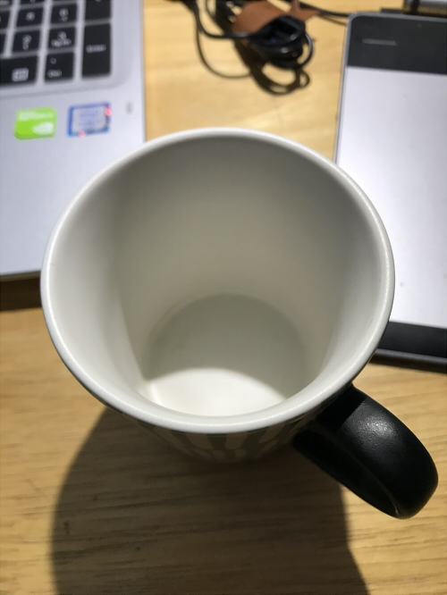
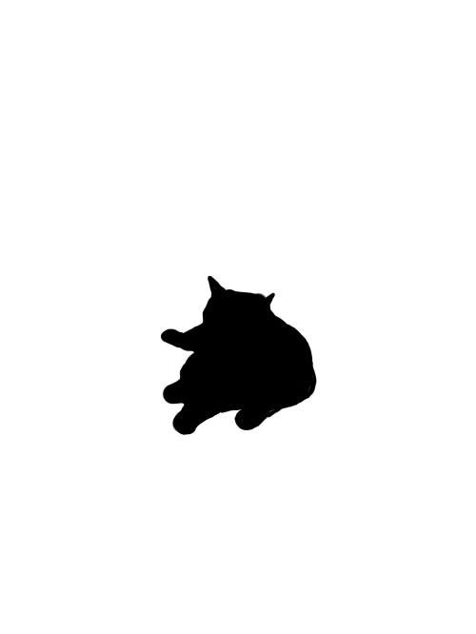
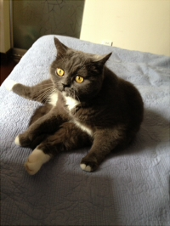
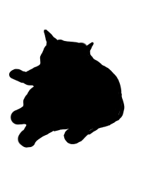
Poisson blending
Target Image
Target Mask
Source Image
Source Mask

Slide 12
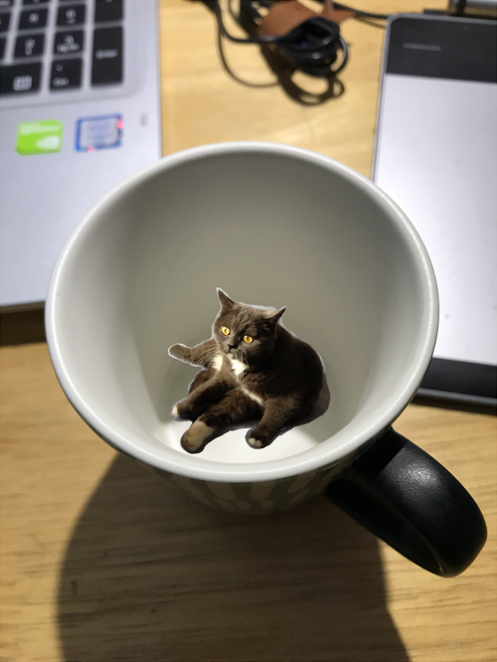
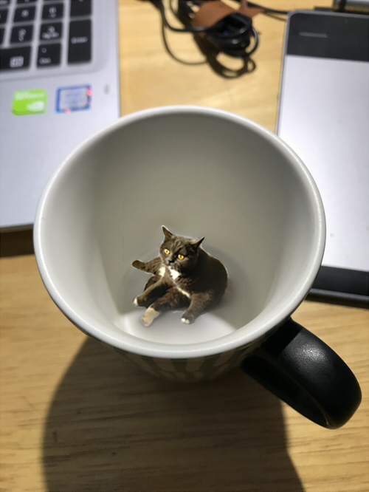
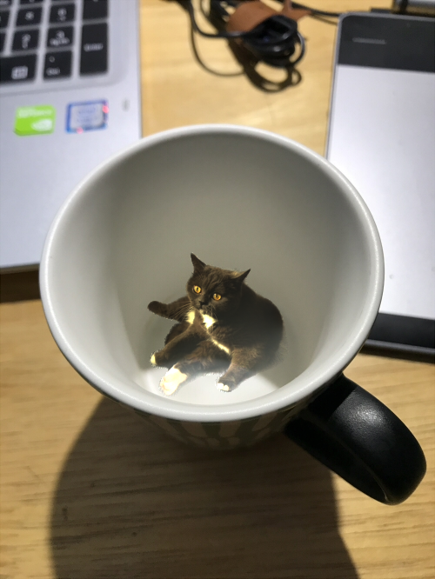
Poisson blending
Cut and paste
Laplacian blending
Poisson blending
Notes:
show some results
So here is our result. On the left is the naïve cat and paste, then middle one is the Laplacian blending, and on the right is the Poisson blending.

Slide 13
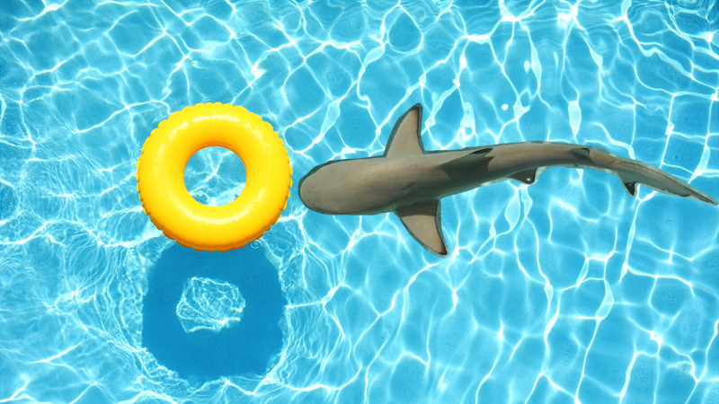
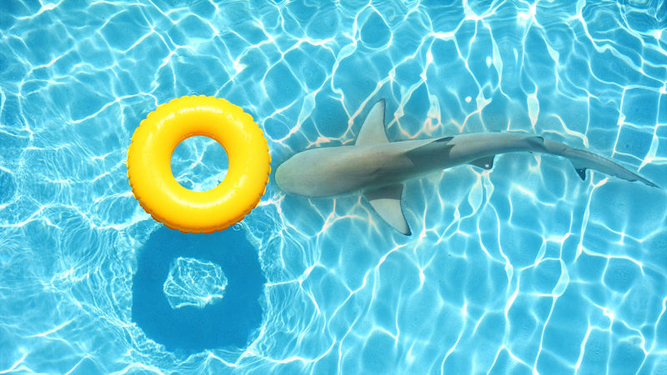
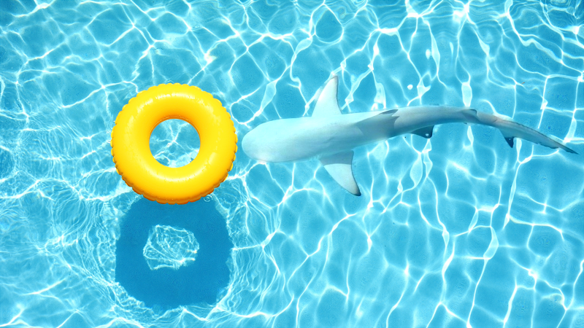
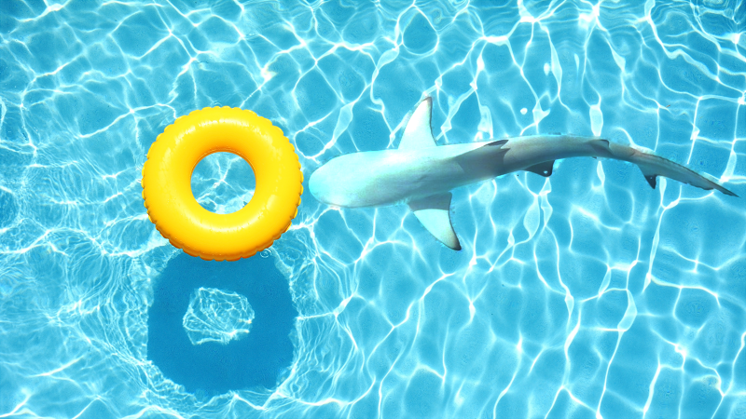
Poisson blending : take logarithm
Cut and paste
Laplacian blending
Poisson blending
Poisson blending in log domain
Notes:
if we do poisson blending in log domain, we can preserve the contrast in source image.

Slide 14
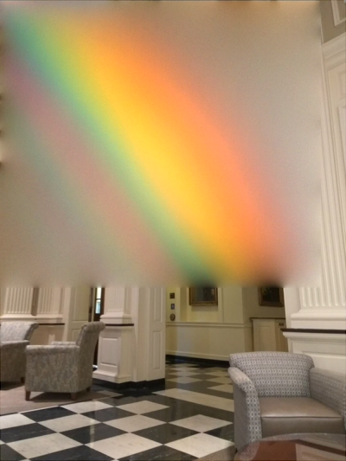
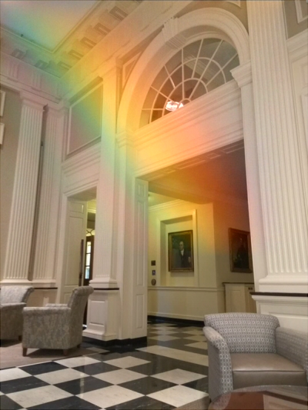
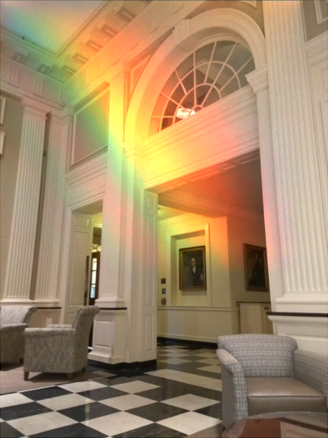
Poisson blending : mixing gradients
Poisson blending
Mixture gradient
Mixture gradient in log domain
Notes:
If you are dealing with objects with holes and want to have a transparent effect, mixing gradients is what you need. The way to do it is simple, you just set the target gradient with the maximum gradient of source image and target image.

Slide 15
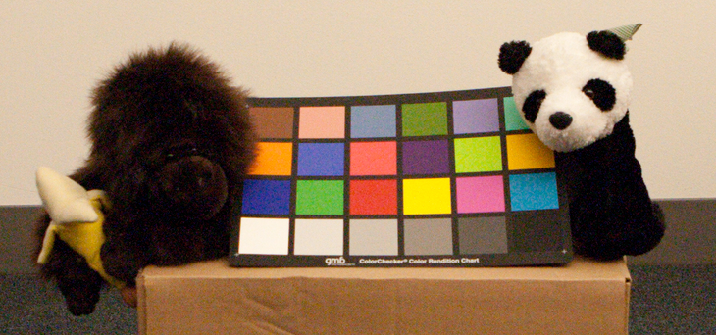
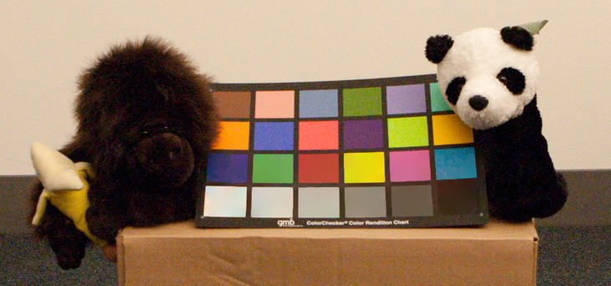
Poisson blending : texture flattening
Original image
Texture flattened image
Texture got flattened
Notes:
Poisson blending can also be used to flatten textures. To do this, we need to do a edge detection first, if an edge is not detected around a pixel, the target gradient is set to 0.
We did a texture flattening in this region, it’s clear to see that the two rows down here is smoother then original image.

Slide 16
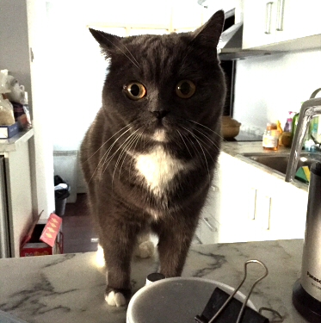
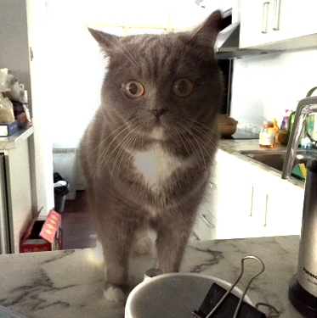
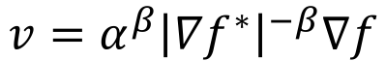
Poisson blending : local illumination change
$$v=α^{β}{\left|∇f^{∗}\right|}^{−β}∇f$$
Original image
Cat’s illumination changed
Notes:
We also did the local illumination change. It can be used when a portion of an image is under exposed or over exposed.

Slide 17
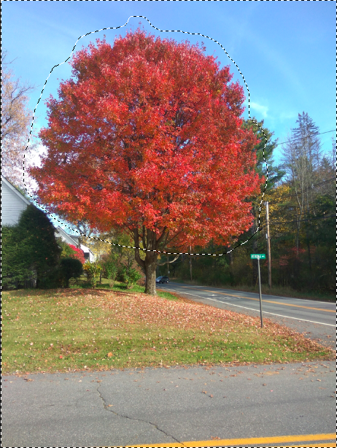
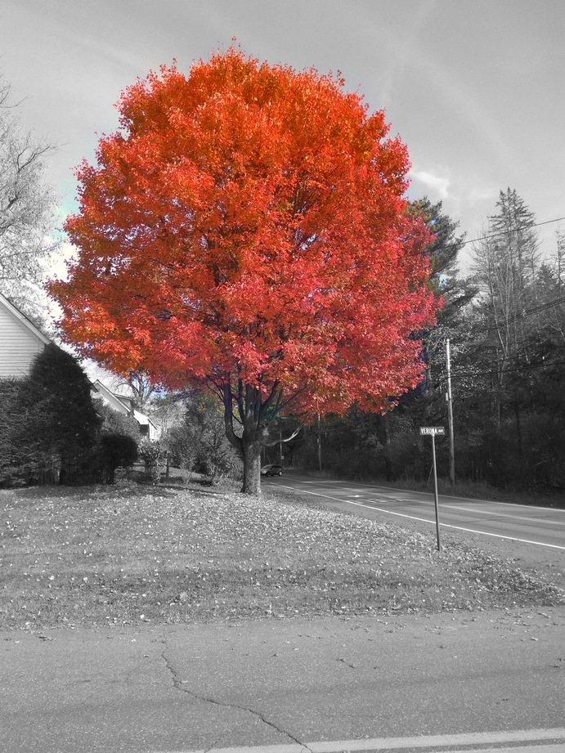
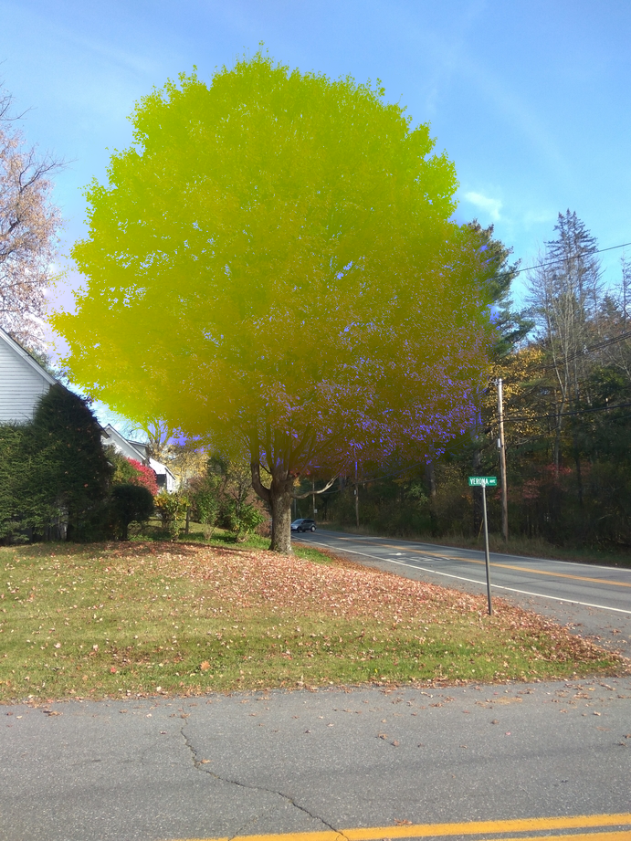
Poisson blending : local color change
Original image
Selected region decolorized
Selected region color changed
Notes:
The next we did with poisson blending is local color change. The task of only turning a part of an image’s color usually can be performed by precisely selecting an object and then changing the color, but poisson blending frees the user from tedium of precise selection.
In this example we can see, we selected a region slightly larger than the tree, but still got nice result from the loose selection.

Slide 18

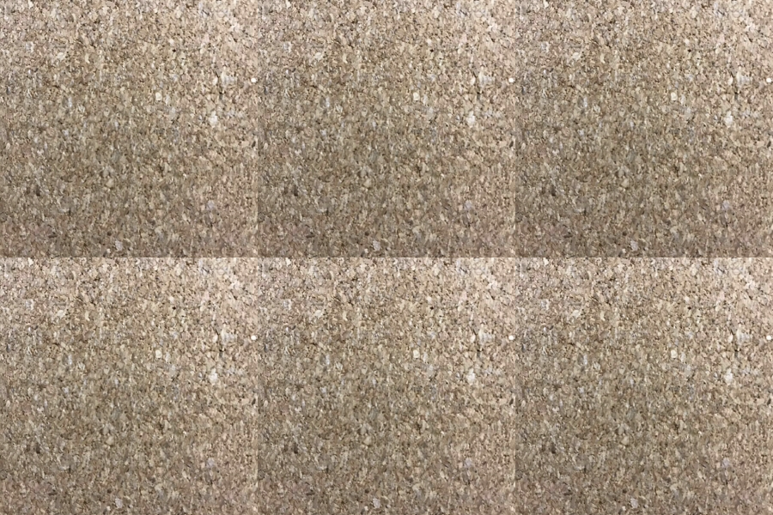


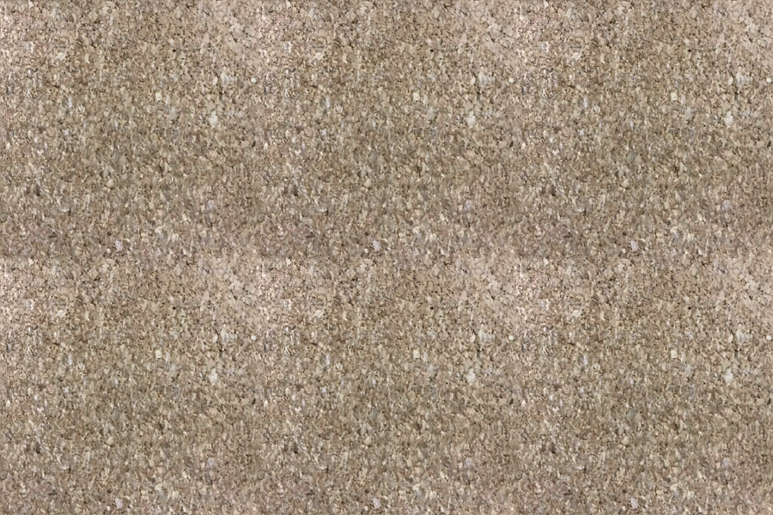

Poisson blending : seamless tiling
Naïve tiling
Seamless tiling
Notes:
Here we has some texture images that we want to tile. However, we can see that if we tile them naively, the boarder is very obvious.
If we use passion blending and set the boundary condition to the opposite side of the boarder, and the value of boarder pixels equal to the average of itself and its opposite pixels.
then we will get a seamless tiling.

Slide 19
reference
Patrick Pérez, Michel Gangnet, and Andrew Blake. 2003. Poisson image editing. In ACM SIGGRAPH 2003 Papers (SIGGRAPH '03). ACM, New York, NY, USA, 313-318. DOI: https://doi.org/10.1145/1201775.882269
http://sepwww.stanford.edu/data/media/public/sep/morgan/texturematch/paper_html/node3.html
http://eric-yuan.me/poisson-blending/
Raanan Fattal, Dani Lischinski, and Michael Werman. 2002. Gradient domain high dynamic range compression. In Proceedings of the 29th annual conference on Computer graphics and interactive techniques (SIGGRAPH '02). ACM, New York, NY, USA, 249-256. DOI=http://dx.doi.org/10.1145/566570.566573
http://graphics.cs.cmu.edu/courses/15-463/2005_fall/www/Lectures/Pyramids.pdf
http://cs.haifa.ac.il/hagit/courses/ip/Lectures/Ip11_MultiscaleRepx4.pdf

